Slide 1
FRONT END LAYOUT
BACKEND STORAGE
REACT LAYOUT
This is where we provide input through a GUI about the text, images etc
This is where the files from the front end layout are stored in the firebase database
This is where the files from the firebase backend are fed to the React Files

Slide 2
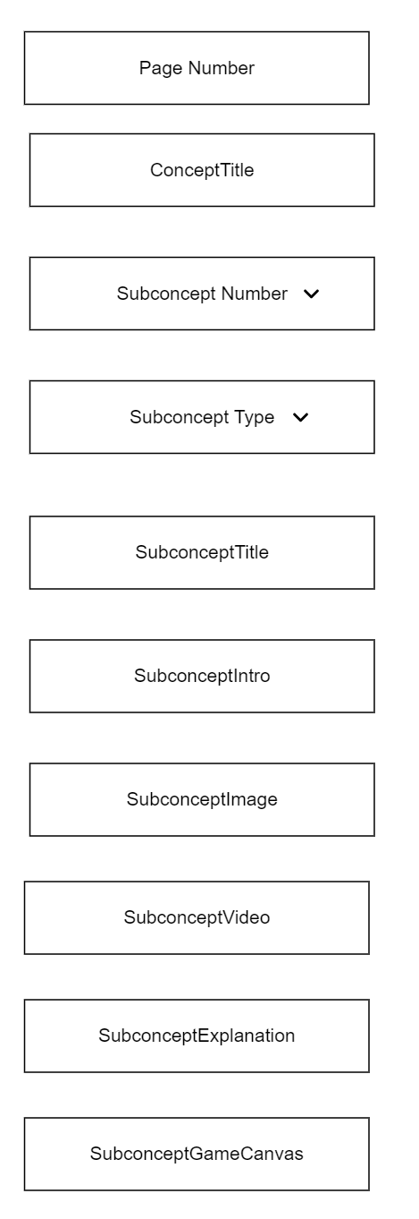
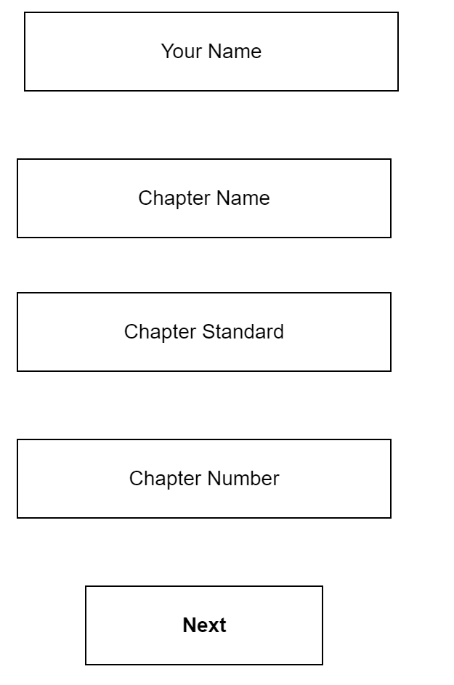
FRONT END LAYOUT
Moqups Link

Slide 3
Backend Layout
ConceptTitle
Type
Title
SubConcept1
Page 1
Intro
VizContent
“ChapterId”
“Pages”
SubConcept2
Image
Page 2
Video
Explain
Page 3
Game
PageInfo

Slide 4
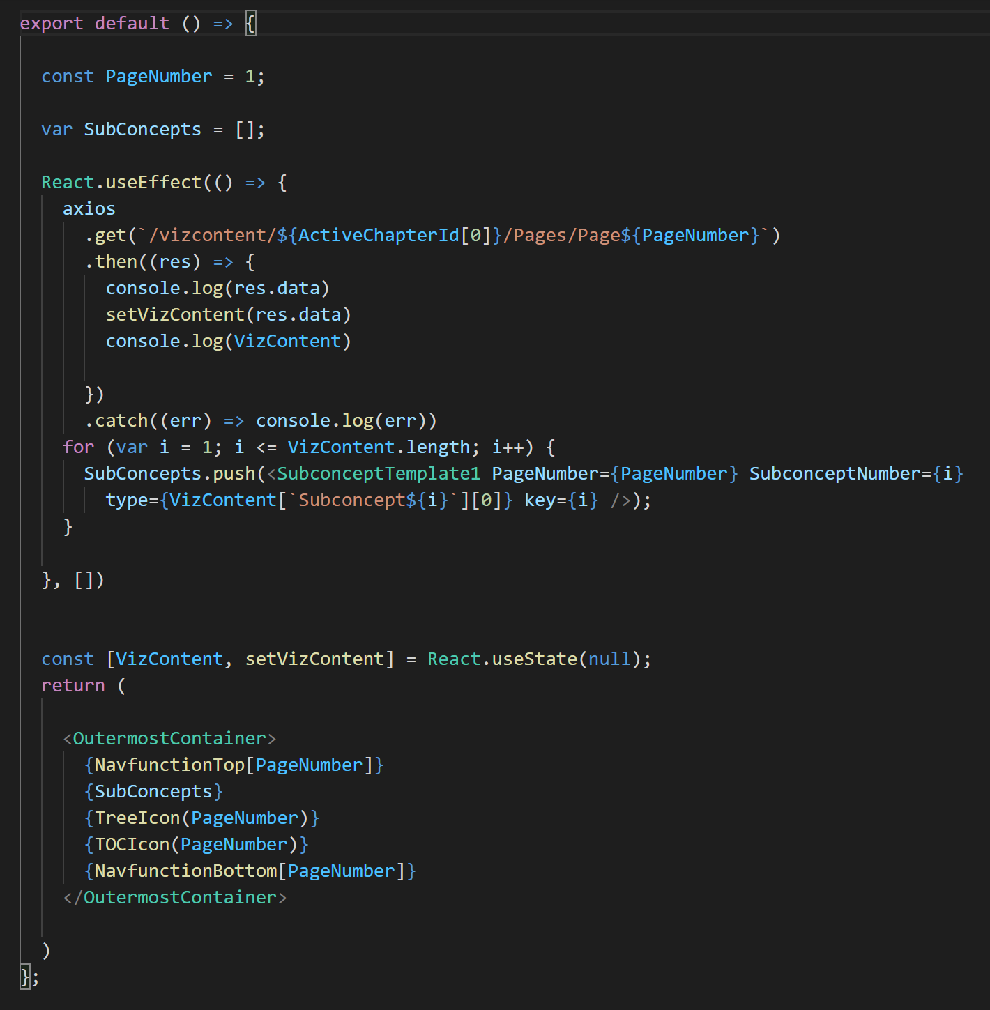
React Layout (VizBookPage)
Page Number
Create array to store SubConcepts
Get all backend data for the page and store it in React State
Fill SubConcepts array with backend data
Top NavBar
Tree and TOC
Bottom NavBar

Slide 5
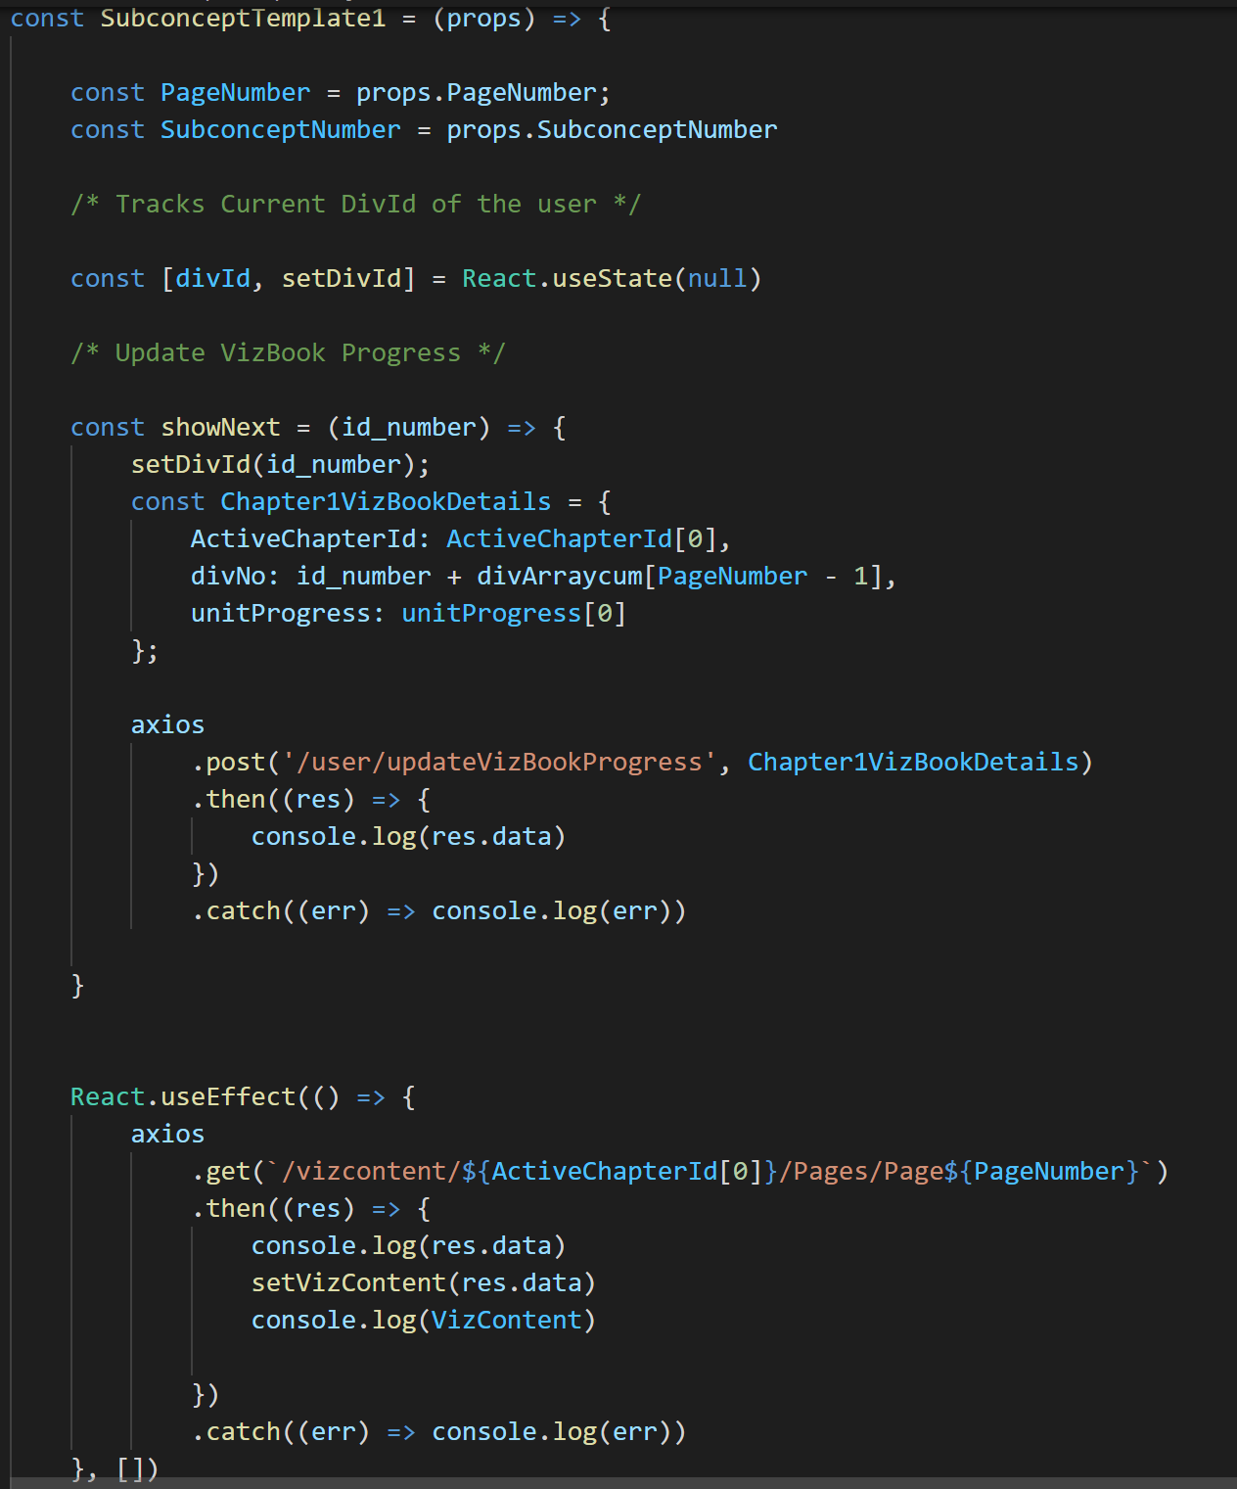
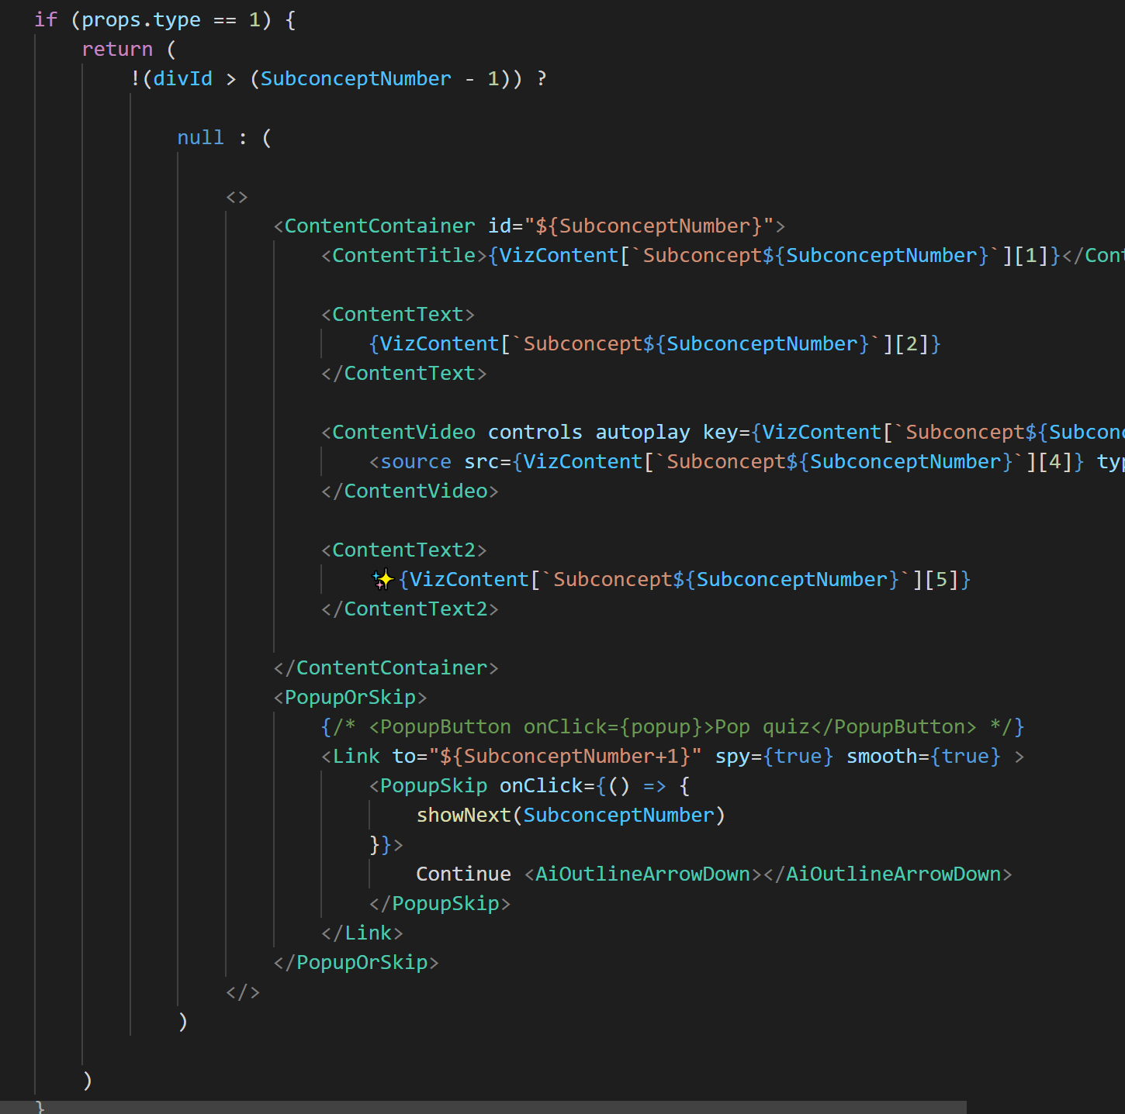
SubConceptTemplate

